Slide 1
MACHINE LEARNING CLASSIFICATION PROJECT
Iris Flower Classification Pipeline
Comparing Logistic Regression and Decision Tree Models Step-by-Step
Data Exploration • Pipeline Preprocessing • Model Evaluation • Decision Boundaries

Slide 2
1. PROJECT OVERVIEW
What is this Project About?
The Main Goal
The Objective:
Build a machine learning pipeline to accurately identify 3 different species of Iris flowers based on physical measurements.
Two Different Approaches:
We test two classic algorithms to see how they make decisions:
1. Logistic Regression: Uses mathematical formulas and smooth boundary lines.
2. Decision Tree: Uses simple if-else questions (like a flowchart).
Why This Matters:
Comparing a linear model with a tree model helps us find the best balance between high accuracy and easy explainability.
Our 4-Step Process
Step 1: Data Check (EDA)
Inspect the dataset, verify data quality, and confirm all 3 flower species are equally represented.
Step 2: Smart Preprocessing
Split the data fairly (80% train, 20% test) and scale measurements without cheating or data leakage.
Step 3: Model Training
Train both Logistic Regression and Decision Tree models on the exact same training flowers.
Step 4: Comparison & Decision
Test both models on unseen flowers and choose the best one for real-world deployment.

Slide 3
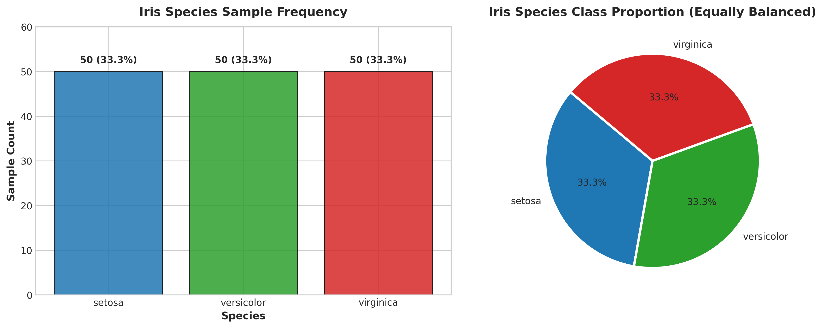
2. DATA EXPLORATION
Understanding the Data: The Iris Dataset
Key Dataset Facts
150 Total Samples:
We have 150 flower records in total, with zero missing or invalid values.
3 Equal Species:
Exactly 50 Setosa, 50 Versicolor, and 50 Virginica (perfectly balanced 33.3% each).
4 Measurements per Flower:
Sepal Length, Sepal Width, Petal Length, and Petal Width (measured in cm).
The Big Pattern:
Petal measurements are by far the most useful feature:
• Setosa petals are very small and completely separate.
• Versicolor and Virginica petals look very similar and slightly overlap.

Slide 4
3. PREPROCESSING & SETUP
Training the Models Safely (Preventing Cheating)
Fair 80/20 Train-Test Split
120 Flowers for Training (80%):
The models study these 120 flowers to learn the difference between species.
30 Flowers for Testing (20%):
Kept strictly hidden until testing time. Exactly 10 of each flower type to ensure a fair test.
Why Stratified Splitting?
It guarantees that the test set isn't accidentally filled with only one flower species.
Why We Used a Scikit-Learn Pipeline
The Common Mistake (Data Leakage):
If you scale numbers across all 150 flowers first, the model 'peeks' at test data statistics. This gives fake, overly optimistic scores.
Our Solution (Scikit-Learn Pipeline):
We bundled the Scaler and Model together into an automated Pipeline. The scaler learns ONLY from training flowers.
The Result:
100% honest, leak-free evaluation that reflects real-world performance.

Slide 5
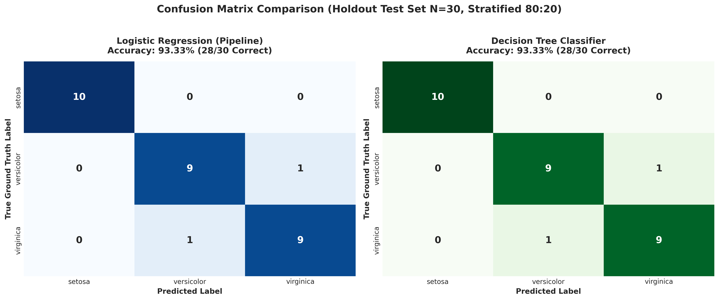
4. MODEL EVALUATION
Performance & Results: 93.3% Accuracy
How Well Did They Perform?
Overall Score: 93.3% (28 / 30 Correct)
Both Logistic Regression and Decision Tree got 28 out of 30 unseen test flowers correct.
Setosa: 100% Perfect (10 / 10)
Neither model made any mistake on Setosa. It is very easy to identify.
Versicolor: 90% (9 / 10 Correct)
9 correct, 1 mistaken for Virginica.
Virginica: 90% (9 / 10 Correct)
9 correct, 1 mistaken for Versicolor.
Why the 2 Mistakes?
Both models struggled on the exact same two flowers (Index 77 and 134). Their petal sizes are on the natural borderline where both species look identical.

Slide 6
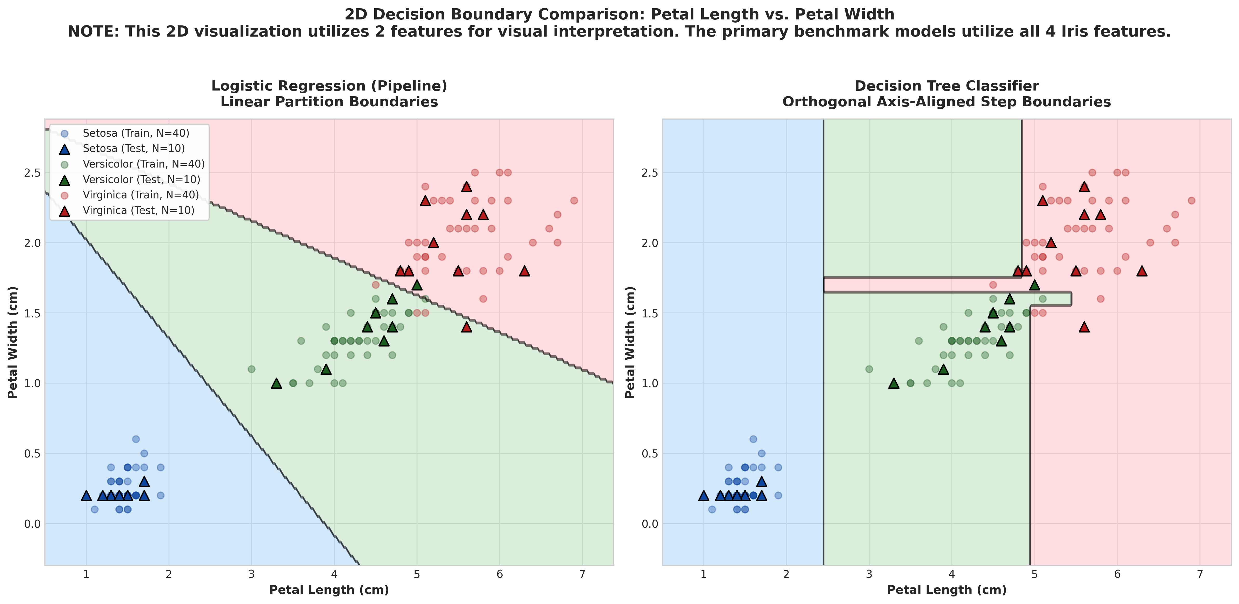
5. SPATIAL VISUALS
Visualizing How Each Model Thinks (2D Boundaries)
How Do the Models Draw Boundaries on Petal Size?
• Logistic Regression (Left) draws smooth, straight lines across the graph.
• Decision Tree (Right) cuts the graph into rectangular boxes and steps using if-else rules (e.g. Petal Length > 2.5 cm).

Slide 7
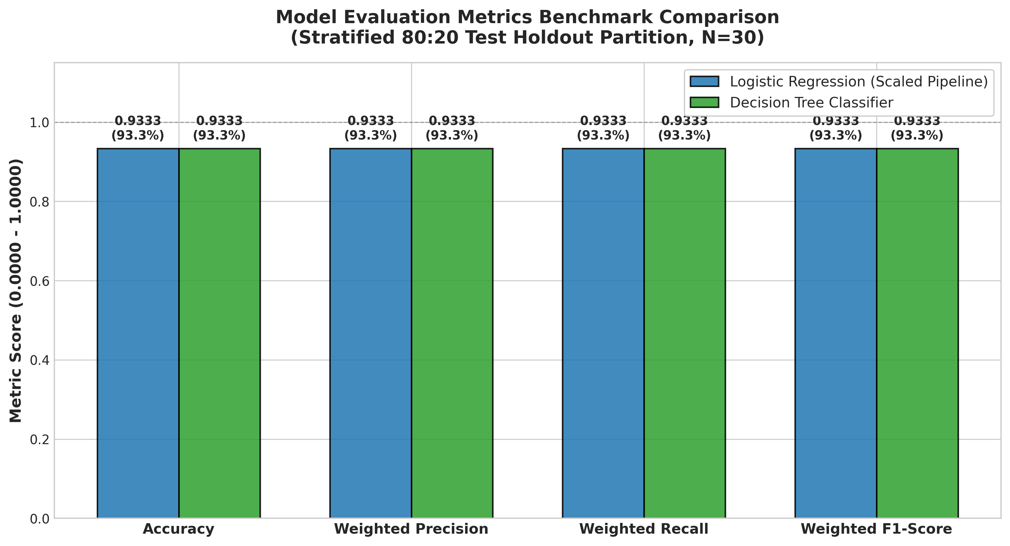
6. CONCLUSION
Which Model Should We Use & Key Takeaways
Our Recommendation for Real-World Use
Winner: Logistic Regression Pipeline
Why? It provides confidence probabilities (e.g., '92% chance Versicolor') rather than just a plain guess, making it safer for production systems.
Alternative: Decision Tree Classifier
Great if you need to explain rules to non-technical users in plain English ('if petal < 2.5 cm, then Setosa').
Best Practice Applied:
Always use a Scikit-Learn Pipeline to prevent data leakage and guarantee honest test accuracy.
Bottom Line:
Both models achieved an identical 93.3% accuracy, confirming that simple, well-engineered models work exceptionally well.

